Slide 1
Project Pitches!
DATA515 // 26wi // 2/3/2026

Slide 2
Sarah: Identifying Hidden Flood Risk in Seattle
Data
Observed flooding:
Seattle Customer Service Requests (Filter for flooding / drainage–related request types)
Seattle Infrastructure Data Layers, Sewer and Drainage (GIS)
Rain Gages (Rainfall measurements granular)
SPU DWW Drainage Basins (Where water flows / collects)
SPU DWW Catch Basins / Inlets / Drainage Points (Where surface water enters)
Rainfall measurements city wide:
NOAA Hourly Precipitation Data (Seattle)
Elevations in Seattle:
2021 USGS Lidar DEM: King County, WA
Project: reusable analysis tool
Task: Compare the observed number of flooding reports for drainage basins in storm events to expected range learned from historical data, given rainfall, elevation, and drainage infrastructure.
○ Use drainage basins, storm event pairs as the unit of data.
Goal:
Detect where reported flooding is inconsistent with historical and physical expectations.
Build an interpretable model to examine the influence of key factors on flooding.

Slide 3
Player evaluation tool for basketball
Type: Research/tool
Goal: Identify potential prospects given market value, player characteristics, team needs
Data: basketball-reference, nba api
Ian Chang

Slide 4
Examining IMDb Trends – Daniel Yan
Data: https://developer.imdb.com/non-commercial-datasets/
IMDb provides a list of datasets with a lot of information available on the site with metrics & information about media hosted. Let’s examine how different genres’ popularity changes & examine whether score inflation is an actual phenomenon on the website.

Slide 5


Project Type
Interactive Tool.
Medicare Rx Equity Dashboard
Short pitch
I am developing an interactive dashboard analysing Medicare Part D prescribing patterns across states (2018-2023).
It normalizes prescription rates by beneficiary demographics like age groups, low-income subsidy status, ESRD patients, and rural vs. urban divides for fair state comparisons.
Researchers filter by drug class (statins, antidiabetics) and population subgroups to explore interactive choropleth maps, time trend charts, and comparison tables. States colour-code by prescribing intensity: Texas red (high volume), California green (low), instantly revealing geographic disparities, preventive care gaps, and plan performance differences.
Data Sources
Medicare Part D Prescribers by Geography & Drugs (CMS)
Medicare Part D Enrollment by Demographics (CMS)
Name: Fatima Fazil

Slide 6
Parking Pal - Presenting Data
Pitch: Wouldn’t it be great to figure out where you’re least likely to get ticketed when parking in Seattle?
Output: dashboard-like tool allowing users to explore when and where tickets were given: most common streets/areas tickets tended to be awarded and times when most tickets tended to be given.
Data Sources:
Seattle Department of Transportation
Seattle Municipal Court
Ideator: Jason Cao

Slide 8
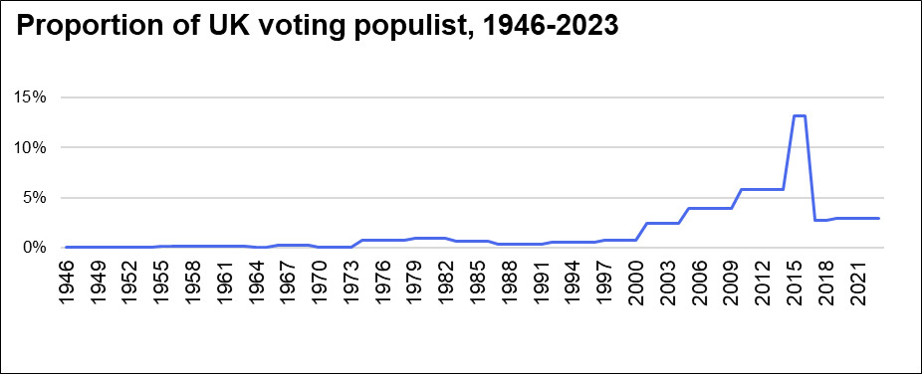
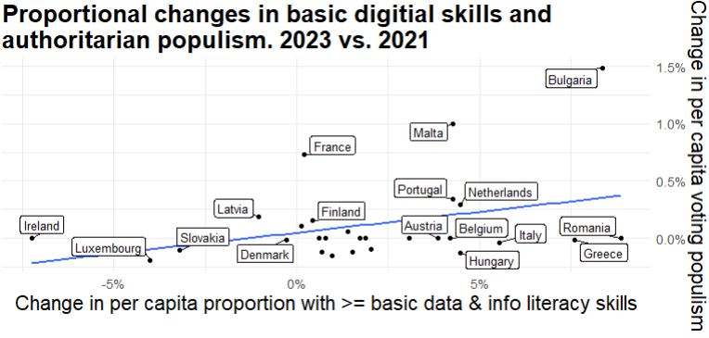
Dive into authoritarian populism and the accessibility of information and technology in Europe! Presently, there’s still relative transparency (i.e. access to data in Europe) and 20-30 countries [rows] to build a wide file underpinning a tool, or maybe a research question?
Timbro Authoritarian Populism
Vote for Authoritarian
Support for Radical Right
Support for Radical Left
Ideologic support (various parties)
Eurostat Digital Skill Index
Information & data literacy
Online communication and collaboration
Digital content creation
Online safety awareness
Online problem solving
Brexit - 2016
“In order to be considered truly free, countries must also have a deep love of liberty and an abiding respect for the rule of law,“ Margaret Thatcher PM 1979-90
LR, KNN, PCA, etc.? Time Series?
Illustrative only
More Features???
Timbro Authoritarian Populism Index: https://populismindex.com/
Eurostat Digital & Information Skills: https://publications.jrc.ec.europa.eu/repository/bitstream/JRC140617/JRC140617_01.pdf
Reporters w/out Borders “Press Freedom Index”: https://rsf.org/en/index?year=2016
United Nations: https://datahub.itu.int/data/?e=AUT
EIU: https://viewpoint-eiu-com.offcampus.lib.washington.edu/data/
Anthropic Claude Usage: https://www.anthropic.com/economic-index#country-usage
Something else??
Jeremy Wise

Slide 11

Naomi Liftman
Vulgar Plates and the Poor DMV Workers
Vanity license plates are pretty cool! But what if you are a terrible person? So you request a vanity plate with a swear word in it! Or a hateful dog whistle!
You wake up a few days later sad because Janice at the DMV wasn’t born yesterday and noticed that you used an obvious hate symbol. But what if she hadn’t noticed?
California manually reviews every license plate submitted to them. Can we help them reject plates more easily? Can Twitter, of all places, help? Let’s create a tool to make Janice's life easier.
Data: https://github.com/veltman/ca-license-plates/tree/master (California License Plates)
https://www.kaggle.com/datasets/muhammadatef/english-profanity-words-dataset (Hate Speech and Profanity on Twitter)

Slide 12
MediQuery: Multimodal Health Assistant
Research Project
The Pitch
RESEARCH PROJECT
A multimodal AI system that allows patients to describe symptoms using text, images, or voice, and receives personalized health insights. By combining vision models (for analyzing skin conditions or injuries), NLP (for symptom descriptions), and audio processing (for cough analysis), the system provides preliminary assessments and relevant medical information.
Why It's Cool
Demonstrates true multimodal fusion by processing visual, textual, and audio data simultaneously. Addresses healthcare accessibility by reducing language barriers and enabling remote preliminary screening. Advances research in cross-modal medical AI and user-friendly health tech interfaces.
Data Sources
1. NIH MedPix Medical Image Database
2. CDC Symptom & Disease Dataset
Text-based symptom descriptions paired with disease outcomes
10,000+ medical images with clinical diagnoses and annotations
Name: Stuti Gaonkar
Presented by: Stuti Gaonkar

Slide 13


Sound2Image Generator
Tool
Sound data: https://www.kaggle.com/datasets/rushibalajiputthewad/sound-classification-of-animal-voice
Caption data:
https://huggingface.co/datasets/d0rj/audiocaps
DH Lee

Slide 14
Predictive Visibility Risk Assessment Tool for Seattle Urban Traffic Safety
Project Type: Research or Create a Tool
What to do: Develop a decision support tool using sunset data, weather data, and historical collision records to identify and predict high-risk time zone across Seattle neighborhoods. We will calculate risk scores by combining low-visibility periods, precipitation, and high-traffic intervals. (Approaches: Weight-based, Regression, or ML)
Why it is cool: Many study focus on nighttime risks or comparing nighttime vs daytime, but our analysis focus on the 30-minute window after sunset. Through this study, we would explore when human eyes are adjusting to shifting light and collisions peak. Having risk scores can help city planners can take precise safety measures.
Sunset data Weather data SDOT Collisions All Years SDOT Collisions Vehicles SDOT GIS Datasets
https://www.fcc-inc.com/dangers-of-driving-during-the-sunset-twilight-hours-2/
https://wtsc.wa.gov/wp-content/uploads/dlm_uploads/2019/03/Daytime-and-Night-Darkness-and-Light_Mar2019.pdf
Notes:
Submission uw netid: gosaeah

Slide 15
Notes:
Submission UW NetID: guoowen

Slide 16




What’s Cooking?
William Hu
Idea/Pitch
1 What - A tool that facilitates/encourages people to cook more efficiently. It will have a database of recipes that users can pick and choose from. After picking a recipe, it will automatically go to your designated (Kroger) grocery store and find all the ingredients needed for the recipe along with the cost. The goal is to help encourage people to make that quick pit stop at the grocery store after clocking off work. The ingredients will be compiled for you with a price estimate.
2 Why/Motivation - It helps remove more barriers/excuses to not cook (which is a nice life skill and saves money). I would also like a tool like this.
Data
4 Kroger Development API - Allows access to find ingredients, stock/availability, and pricing of food ingredients for Kroger stores. There’s a generous request limit so it should work for the goals of this project
5 Recipes Dataset - Any large recipe database works (some filtering/tuning would be necessary regardless)

Slide 17
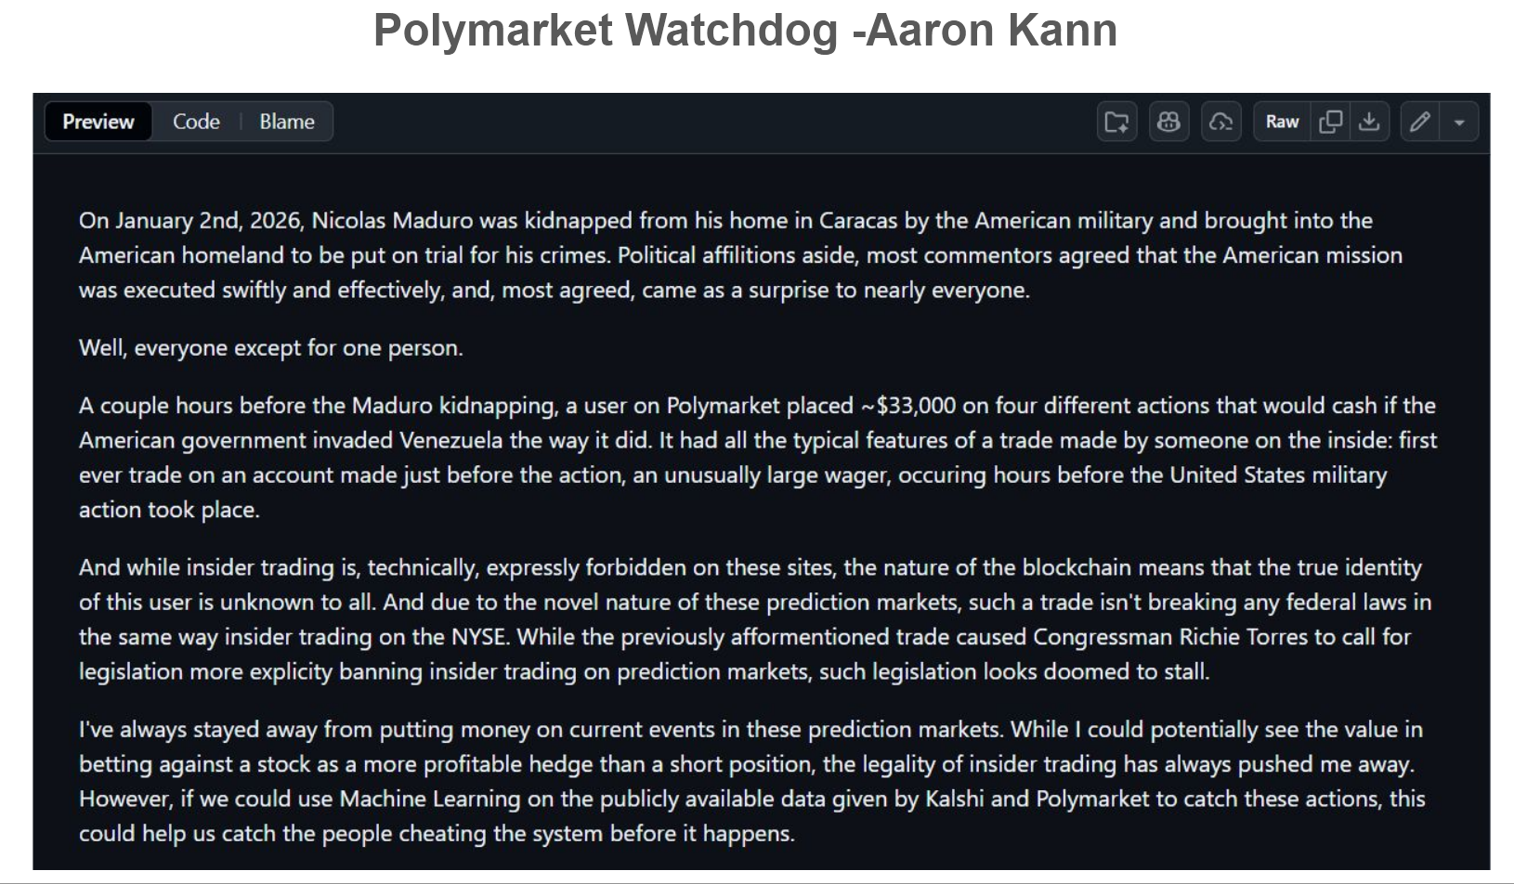

Slide 18





TradeRewind: Time Machine for your Trading Strategies
Project Type: Tool - Algorithmic Trading Strategy Backtester.
What We're Building: Python toolkit that tests trading strategies on historical market data.
Why It's Cool:
Turns expensive trial-and-error into safe, instant validation.
Simulate years of trading in seconds, without risking real money.
Saves traders from costly mistakes before entering real markets.
Data Sources: Multi-source data integration (
and )
Yahoo Finance
Federal Reserve APIs
Priyal Jain

Slide 19






PROJECT PITCH
Breathe Better
DATA 515
Alvin Alias
PROBLEM STATEMENT
“How does air pollution relate to chronic health outcomes across U.S. communities?”
Data Sources
Methodology
Project Output
CDC PLACES
Local chronic disease prevalence
Aggregate EPA Air Quality Data to County Level
Interactive Explorer
Visual dashboard for insights
EPA Air Quality (AQS)
PM2.5 & Ozone Concentration Levels
Merge via FIPS Codes
Reproducible Pipeline
Documented data workflow
Census ACS (5-year)
Demographics & Socioeconomic data
Explore associations using interactive visualizations
Notes:
Links:
CDC Places - https://www.cdc.gov/places/about/index.html
EPA AQS - https://www.epa.gov/aqs
Census ACS - https://www.census.gov/data/developers/data-sets/acs-5year.html

Slide 20
Malicious URL Detection
Andrew Jumanca
ICML-09 Malicious URL Dataset
~2.4M URLs over 120 days
Labels: benign vs. malicious URLs
Will join on:
Tranco Top Sites Ranking
An open, research-grade list of the most popular domains on the internet
What is the goal?
https://tranco-list.eu/
How can we join large-scale URL feature data against independent domain popularity signals to better understand and detect malicious URLs?
https://www.sysnet.ucsd.edu/projects/url/#datasets
Project Type: Online Interactive User Tool
Feb 2026

Slide 22
Public Libraries and Schools
Project type: Research
Compare library usage with local school literacy rates or standardized test scores
Find any patterns among public libraries and public schools
Data (tentative):
Seattle Public Library Data
School District data - literacy rates or scores on standardized tests
Jolene Pern
Notes:
Checkouts by Title | City of Seattle Open Data portal

Slide 23

Project Proposal -
Eva Reutercrona
Title: What is Seattle Reading?
Project Type: Answer a Research Question
Pitch: Are Seattle Public library users checking out all of the popular books on Goodreads? Were the people of Seattle checking out Twilight and other vampire books in 2005 to fight the seasonal depression? I want to take a deeper look at the types of books the Seattle readers are checking out from the library by combining the Seattle Public Library data set with data sets from Goodreads that contain plots, reviews, and userbook interactions from a larger audience.
Data sets:
Seattle Public Library: https://www.kaggle.com/datasets/seattle-public-library/seattle-library-checkout-records
Goodreads: https://cseweb.ucsd.edu/~jmcauley/datasets/goodreads.html

Slide 24



Urban Heat
Island Explorer
THE IDEA
Analyze how urban development affects local temperatures and identify neighborhoods most vulnerable to extreme heat. Combine pre-processed satellite temperature data with demographic information to reveal patterns of environmental inequity.
RESEARCH QUESTIONS
RESEARCH
1. Which Seattle neighborhoods experience the highest heat island intensity?
2. Is there a correlation between income levels and heat exposure?
3. How has heat island intensity changed over the past 35 years?
"Climate justice meets data science"
DATA SOURCES (Verified & Available Now)
USGS Surface Urban Heat Island
US Census ACS Demographics
Pre-processed land surface temperature for 50 US cities including Seattle (1985-2020). Annual heat intensity metrics ready to analyze.
Income, race, age by census tract via free API. Python libraries (censusdis). 5-year estimates provide reliable statistics.
ACCESS LINKS:
data.usgs.gov/datacatalog • api.census.gov/data.html • censusdis.readthedocs.io
Sowmya Daddheech
Why it's cool: Real environmental justice insights with data immediately available!
DATA 515 • Winter 2025

Slide 25


Data sources
What & Why
Expected Output
Data-Driven Survival Strategy for U.S. Small Businesses
Project Type: Create a Tool + Present Data
Census Tract Boundaries U.S. Census TIGER/Line Shapefiles
Demographics & Income American Community Survey (ACS)
Business Supply & Industry Density County Business Patterns (CBP)
Competition Intensity Yelp Open Dataset (reviews, ratings, price levels)
Demand Proxy (Foot Traffic) SafeGraph Places & Patterns (open/free subsets)
Over 50% of U.S. small businesses fail due to poor location and industry choice
Census-Tract–level tool integrating demographics, supply, competition, and foot traffic
Models local demand–supply mismatch using LQ and competition intensity
Identifies survival-friendly industries and locations for entrepreneurs and policymakers
Interactive map & analytics showing:
Underserved industries by neighborhood
High-demand / low-competition trade areas
Data-backed recommendations for small business survival
Wonjoon Hwang

Slide 26
📱Intermission🍹

Slide 27
Sarah: Identifying Hidden Flood Risk in Seattle
Data
Observed flooding:
Seattle Customer Service Requests (Filter for flooding / drainage–related request types)
Seattle Infrastructure Data Layers, Sewer and Drainage (GIS)
Rain Gages (Rainfall measurements granular)
SPU DWW Drainage Basins (Where water flows / collects)
SPU DWW Catch Basins / Inlets / Drainage Points (Where surface water enters)
Rainfall measurements city wide:
NOAA Hourly Precipitation Data (Seattle)
Elevations in Seattle:
2021 USGS Lidar DEM: King County, WA
Project: reusable analysis tool
Task: Compare the observed number of flooding reports for drainage basins in storm events to expected range learned from historical data, given rainfall, elevation, and drainage infrastructure.
○ Use drainage basins, storm event pairs as the unit of data.
Goal:
Detect where reported flooding is inconsistent with historical and physical expectations.
Build an interpretable model to examine the influence of key factors on flooding.

Slide 28

WA EV Charging Smart Assistant
My name :Aiden Tan
Project Output: a web chatbot
Build a natural-language chatbot that helps EV owners and planners in Washington State answer questions like:
"Which are the best charging station near UW?"
"Is EV adoption growing rapidly in King County? Are the charging stations keeping up?"
"I drive a Tesla; where are the easiest places to charge while traveling in Washington State?"
Data
WA Electric Vehicle Population Data
This dataset shows information of all Electric Vehicles that are currently registered through Washington State Department of Licensing (DOL).
Electric Vehicle Population Data | Data.WA | State of Washington
Alternative Fueling Stations
EV charging stations(street_address, zip code, pricing, etc…)
EV-MAP Site Data page | EV Mapping and Planning Tool Site

Slide 29
Crop Resiliency
Project Type: Research Question
What are the most and least resilient crops harvested in the US?
This does not only help farmers know which crops make the safest investments. It also helps the USDA, or other, government agency predict and prepare to assist farmers when unpredictable weather conditions damage their profits.
USDA Quick Stats: https://quickstats.nass.usda.gov/
NOAA Local Climatological Data: https://www.ncei.noaa.gov/products/land-based-station/local-climatological-data
James Holtz

Slide 30
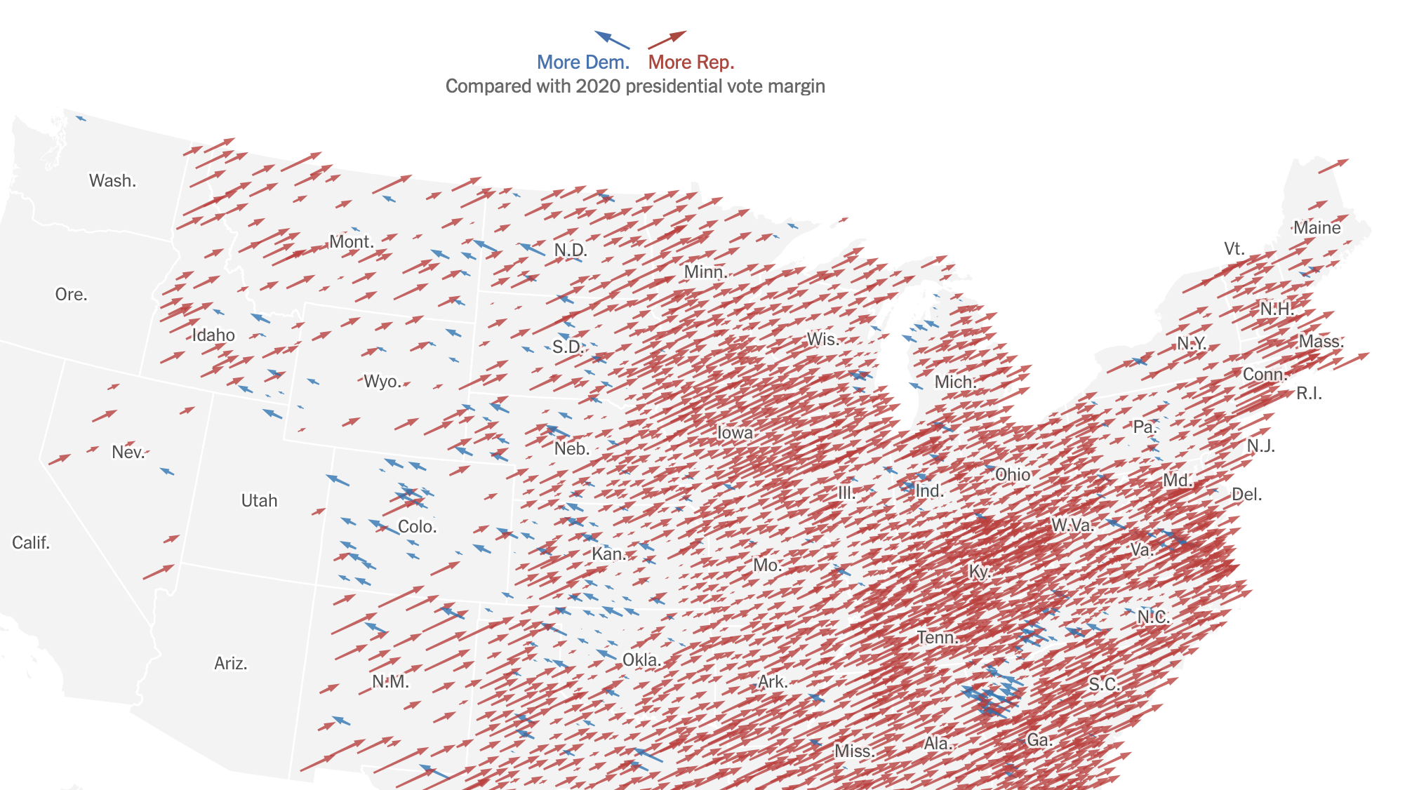
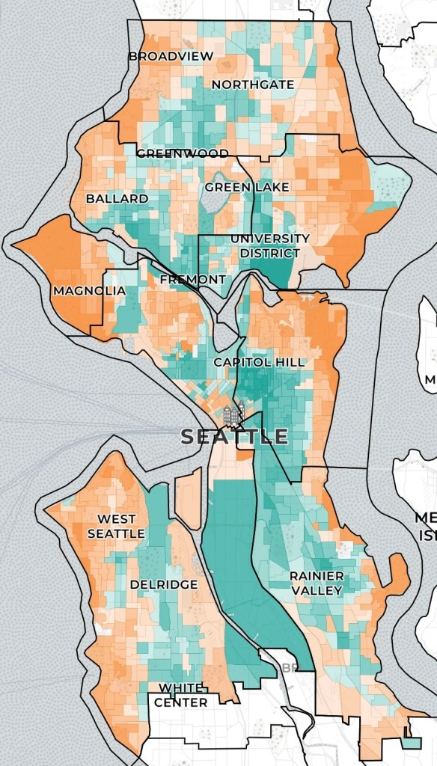
Seattle Elections
Research Project
2025 Mayoral Election Results
Questions to be answered: Which areas are the most "valuable"? Which areas are the most "swingy"?
Which areas are trending towards one side or another?
Data Source 1: Seattle Election Results
Data Source 2: Seattle Voter File
Notes:
Submission: lubarskyzach

Slide 31
The Data Scientist Toolkit Tracker
Project Type: Tool
WHAT DOES THE TOOL DO?
WHAT IS THE VALUE?
DATA SOURCE
This tool will that track commonly used models, libraries, and tools in a data scientist’s workflow, using signals like community adoption, development activity, and stability to show how active and reliable each tool is.
Data science and AI tools change fast, and it’s hard to know which ones are actually worth using. This tracker helps data scientists keep up with the field, decide which tools make sense to adopt, and update their workflows in a way that can improve their productivity.
GitHub AI Repository Rankings
GitHub Release Pages for Key Libraries (e.g., LangChain, LlamaIndex)
Awesome Open-Source AI Tools Lists – tool discovery and categorization
Hugging Face GitHub AI Project Docs Dataset – documentation quality and tool descriptions
By: Arlette Ngabonzima

Slide 32

Plane Your Trip! A Web Tool for Predicting Plane Ticket Prices
In 2023, almost 90% of Americans have taken a commercial flight. Many of us do so regularly
What are the factors that affect plane ticket prices? Can we predict pricing?
Data sources
“Airfare ML : Predicting Flight Fares” (Kaggle) – Flights prices
U.S. Energy Information Administration (EIA) – Fuel prices
Other datasets for sources of ticket pricing
Interested? Come find Henry after this

Slide 33
US Emissions Playground
Project type: Tool
Description: Create an interactive tool which allow users to learn more about sources of US emissions. Users can adjust sector level emissions and see how these hypothetical changes impact emission trajectories, and check if we are on track to meet our climate targets. I think this project is cool because it makes learning about a complex and important topic accessible and interesting.
Data sources:
CO2 and Greenhouse Gas Emissions (Our World in Data)
EPA US Greenhouse Gas Inventory
Catherine Wu

Slide 34
The Data Scientist Toolkit Tracker
Project Type: Tool
WHAT DOES THE TOOL DO?
WHAT IS THE VALUE?
DATA SOURCE
This tool will that track commonly used models, libraries, and tools in a data scientist’s workflow, using signals like community adoption, development activity, and stability to show how active and reliable each tool is.
Data science and AI tools change fast, and it’s hard to know which ones are actually worth using. This tracker helps data scientists keep up with the field, decide which tools make sense to adopt, and update their workflows in a way that can improve their productivity.
GitHub AI Repository Rankings
GitHub Release Pages for Key Libraries (e.g., LangChain, LlamaIndex)
Awesome Open-Source AI Tools Lists – tool discovery and categorization
Hugging Face GitHub AI Project Docs Dataset – documentation quality and tool descriptions
By: Arlette Ngabonzima

Slide 35

Calamity-Watch
A Real-Time Global Multi-Hazard Monitoring Dashboard
Project Type: Geospatial Tool / Interactive Map
I am building an interactive web application that aggregates real-time natural disaster data into a single global dashboard. The system combines NASA FIRMS wildfire hotspot data with GDACS multi-hazard alerts (earthquakes, floods, cyclones, and volcanoes) to provide a unified, map-based early-warning view. This is cool because it turns live satellite and disaster-alert feeds into an accessible visual monitoring tool useful for researchers, planners, and travelers.
Data Sources:
NASA FIRMS API - Near real time wildfire hotspot data from MODIS and VIIRS satellites
GDACS API - Global alerts for earthquakes, floods, tropical cyclones, and volcanic eruptions
Name: Sreeraj Parakkat

Slide 36
StreamSurge
A Streaming Data Monitoring Tool for Music Popularity
Project Type: Tool project
StreamSurge is a Python-based tool that simulates real-time music streaming data, compares it against historical baselines, and detects unusual spikes or drops in popularity. The project focuses on software and system design—data ingestion, monitoring, anomaly detection, and visualization—rather than prediction or research analysis. It’s cool because it turns static music data into an interactive monitoring system similar to what analysts use in real-world platforms.
Data Sources (Tentative):
Spotify Charts — daily streaming counts by track and country (historical batch data)
Simulated Live Stream — incremental replay of historical streaming data to emulate real-time ingestion
Notes:
Submission: srinivasanavanthikaa

Slide 37
Predicting Flight Delays
Johnny Liang
- Project type: Tool
- Create a tool that uses weather pattern data (temperature, air pressure, etc.) to predict the length of delays upcoming flights.
- Help individuals plan their trips, help airlines prepare in advance.
- Sources:
1. Flight delay data: https://www.transtats.bts.gov/ontime/
2. Weather data: https://www.ncei.noaa.gov/products/land-based-station/integrated-surface-database
3. Airport data: https://datahub.io/core/airport-codes

Slide 39


or
?
A Business Survival Simulator for NYC
Walk along the Ave: you’ll see packed shops, empty storefronts, closed businesses. Some areas are busier than others. Why do they survive while others close?
Can neighborhood conditions be used to estimate business survival?
Data Sources (data.cityofnewyork.us):
NYC Issued Business Licenses: regularly updated with business category, location, license issue and expiration date
NYC 311 Service Requests (2020 to present): resident-reported neighborhood complaint type, time, location
Project Type: Tool Project - estimated probability of surviving past 3 years, 5, etc.
Hannah Sun

Slide 40


Early Warning Signals from Aviation Near-Miss Narratives
Anna Tender
Project Output: Research & Analytics Tool
NASA ASRS: Voluntary aviation safety; report narratives; near-misses, coded fields (phase of flight, anomaly type, reporter role)
NTSB accident & incident data: Occurrence categories; Event dates and outcomes
Analyze aviation safety narratives to detect emerging aviation hazards
Group narratives using NLP clustering
Compare hazard trends to official accident and incident data
Test whether increases in near-miss reports precede formal accident and incident outcomes

Slide 41




FOOD DESERT PROJECT
JIANNA WONG
Project Output: map visualization + data tool
Show the intersection of income and access to supermarkets vs. fast food
Find the riskiest food desert areas to live in
Show over the years how this has changed
Data:
USDA Food Access data
Census Bureau ACS 5-Year Estimates
Local Data for Better Health, Census Tract Data

Slide 42
Calamity-Watch
A Real-Time Global Multi-Hazard Monitoring Dashboard
Project Type: Geospatial Tool / Interactive Map
I am building an interactive web application that aggregates real-time natural disaster data into a single global dashboard. The system combines NASA FIRMS wildfire hotspot data with GDACS multi-hazard alerts (earthquakes, floods, cyclones, and volcanoes) to provide a unified, map-based early-warning view. This is cool because it turns live satellite and disaster-alert feeds into an accessible visual monitoring tool useful for researchers, planners, and travelers.
Data Sources:
NASA FIRMS API - Near real time wildfire hotspot data from MODIS and VIIRS satellites
GDACS API - Global alerts for earthquakes, floods, tropical cyclones, and volcanic eruptions
Name: Sreeraj Parakkat

Slide 44

Swimsafe WA
Project output: reusable data (a simple web app)
Advise whether it is safe to swim at a Washington beach, lake, or swim spot
Interactive map visualization with zoom and click
Search feature to find specific swim locations
Data:
Washington State Department of Ecology – Beach Program water quality data
Bacteria measurements and swim advisories
USGS environmental data
Water temperature and other context
Name: Oviya Muralidharan
Notes:
Factors considered
Bacteria contamination
Toxic algae blooms
Water temperature
Water body type (saltwater vs freshwater)

Slide 45

Book Club / Hobby Group Manager
Category: Tool/ Website /App? I am open to making any of these.
Pitch: I love book clubs but it’s almost impossible to maintain a book club and coordinate what book to read, when to meet up, deadlines to set, etc. My solution: a dedicated web platform (or app) that centralizes everything book clubs need: propose and vote on books/other decisions democratically, set synchronized reading schedules with progress tracking, host forum discussions, and coordinate meetings. I also imagine and would like to make the tool able to support other hobby groups too, whether that be sports watching, DND + board games, music/bands, etc.
Data Sources + APIs: Google Books, Open Library, Goodreads, Google calendar API, Meet-up API
Possible Features: Group creation, voting, progress setting, discussion forums, member profiles, meeting scheduling
Ha Tien Nguyen

Slide 46




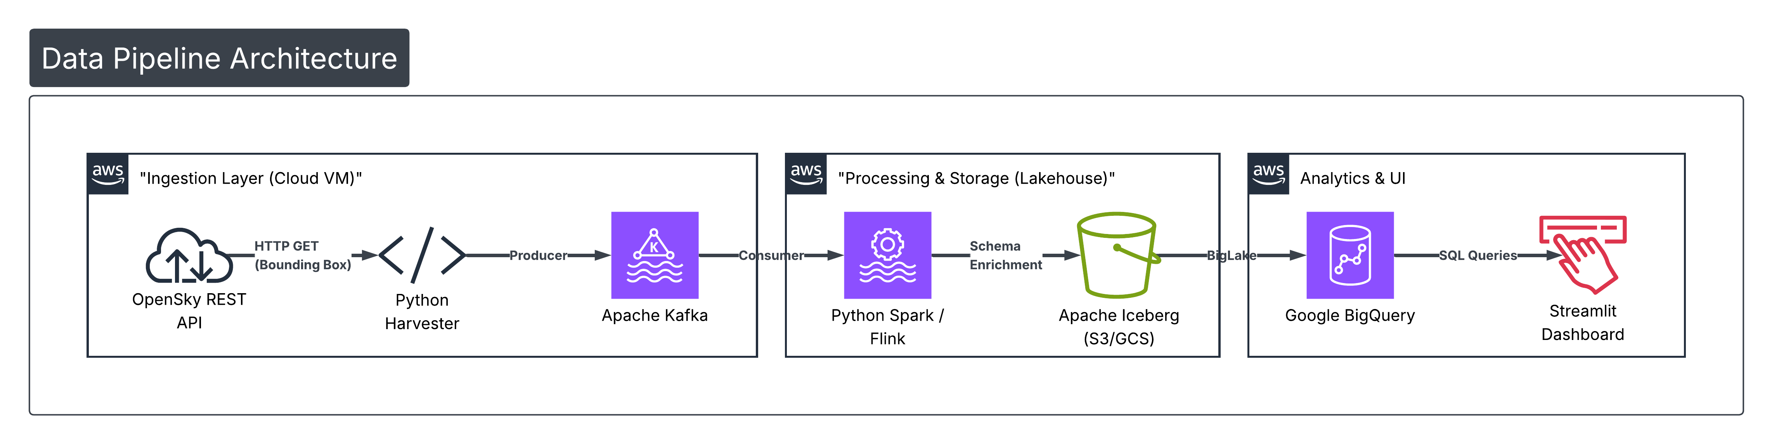

SUPER BOWL SKY
To build a real-time Geospatial Lakehouse that monitors all aviation activity within a 50-mile radius of Levi’s Stadium during Super Bowl LX. The system will automate the ingestion of high-frequency state vectors, calculate estimated carbon emissions per flight, and utilize Iceberg Time-Travel to audit the 'Celebrity vs. Commercial' congestion ratio.*
Reusable Tool/Research | Data: The Open Sky Network, ICAO Carbon Emissions | Pavankumar S

Slide 47


Segment Hunting
Q: How do traffic features affect people’s ability to run/ride fast on a segment? (research project)
Choose a handful of similar segments (length, elevation gain) to analyze (fastest time, spread over top 10, total number of efforts) in slightly different places around the city
Implications: safety, weakest segments
Two(+) datasets: strava segment details and geodata from the city of Seattle (join on location)
Access segment details via strava api or web scraping
Potentially use SDOT sidewalks, intersections, crosswalks data
Jonathan Grothe

Slide 48
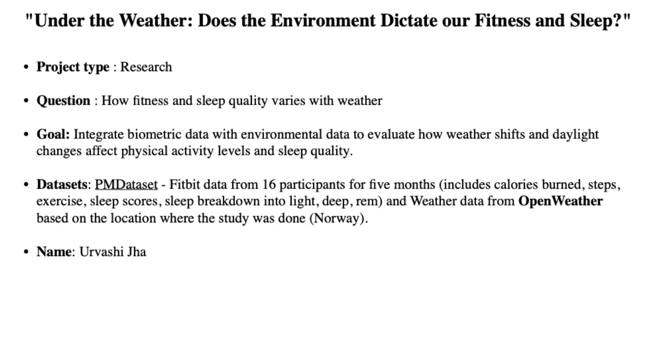

Slide 49
Outlier Detection in Real-World Health Data Using All of Us Research Program Project: Research + reusable analysis workflow (tool)
Data:
All of Us Research Program
Pros: high external validity (real clinical variation), longitudinal EHR + program-collected measures + surveys, large scale for rare patterns
Cons / constraints: cannot remove or copy participant-level data (no screenshots/downloads); cannot attempt re-identification; cannot link participant-level external datasets without explicit permission; some fields are suppressed/generalized to reduce re-identification risk
Methods
Build an outlier detection pipeline for patient-level physiology and lab profiles using Mahalanobis distance as a baseline, then compare to a few alternatives
Analyses run in the cloud-based Researcher Workbench: you create a project workspace and do SQL + notebook analyses against curated datasets
Example datasets: EHR labs/vitals, collected measurements like BMI, blood pressure
Name: John Tilelli
Notes:
Code of conduct: Data: https://support.researchallofus.org/hc/en-us/articles/360039585391-Understanding-OMOP-Basics
Vitals panel (continuous, widely available): systolic/diastolic BP, BMI, heart rate, temperature (from MEASUREMENT)
Basic labs panel (continuous, common): glucose, HbA1c (if available), creatinine, sodium, potassium, hemoglobin/hematocrit, WBC, ALT/AST (from MEASUREMENT)
Utilization context (helps interpret “outliers”): visit counts, inpatient vs outpatient flags (VISIT_OCCURRENCE)
Stratify by age/sex (and optionally site) to reduce spurious “outliers” driven by mixing populations

Slide 51
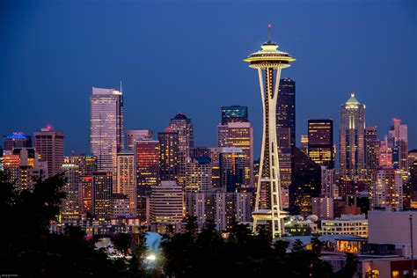










Seattle!
the city of coffee
Review data I scraped from my coffee subscription service
Additional roaster information we decide on (mission, store availability, etc)
Julia Glasser
Shoutout https://www.makewordart.com/ for word art
Notes:
Short pitch - We live in an amazing city for coffee! I want to make a tool for people who would like to support their local roasters and are curious which one would be a good match for them. Do they prefer dark roasts? Is fair trade something important to them? Do they have a grinder or do they want to buy pre-ground? Do they only want something they could pick up at the local QFC/Safeway? I think there are a lot of directions we could take this tool and I already have some data about different brands and reviews/prices for products they offer. Tentative additional data could be focused on availability in local stores, information about the roasters (do they have specific missions or ownership), or where they are located.

Slide 52

WA Hiking Trail Patterns
By Elsie Wang
Tool + Data Presentation Project
Description
Interactive analytics and visualization tool exploring when and where people hike in WA and seasonal trail conditions; provides hiking windows
When does hiking activity decrease and increase in WA?
How doe seasonality differ by region?
When’s the best time to hike a certain trail?
Data Sources
Washington Trail Association Trip Reports
Timestamps, trail names, regions, condition tags
Washington Trail Geometry & Metadata
OpenStreetMap, WA State Parks GIS
National Weather Service API
Real-time weather conditions

Slide 53
Title: Global Olympic Impact
Project Type: Answer Research Questions
Pitch:
Do countries that host the olympics medal more often?
How is a country is affected by hosting the olympics?
Can look at:
Health
Nutrition
Mortality
economy
Potentially try to predict how the LA olympics will affect the US.
Data Sources:
https://www.kaggle.com/datasets/harshvgh/olympics
https://www.kaggle.com/datasets/carolinacappato/olympic-games-info
https://www.kaggle.com/datasets/miguelroca/global-health-nutrition-mortality-economic-data
Name: Sophia Koehn

